Slide 1
Roland Avenue Cycle Track Meeting
June 14, 2018

Slide 2
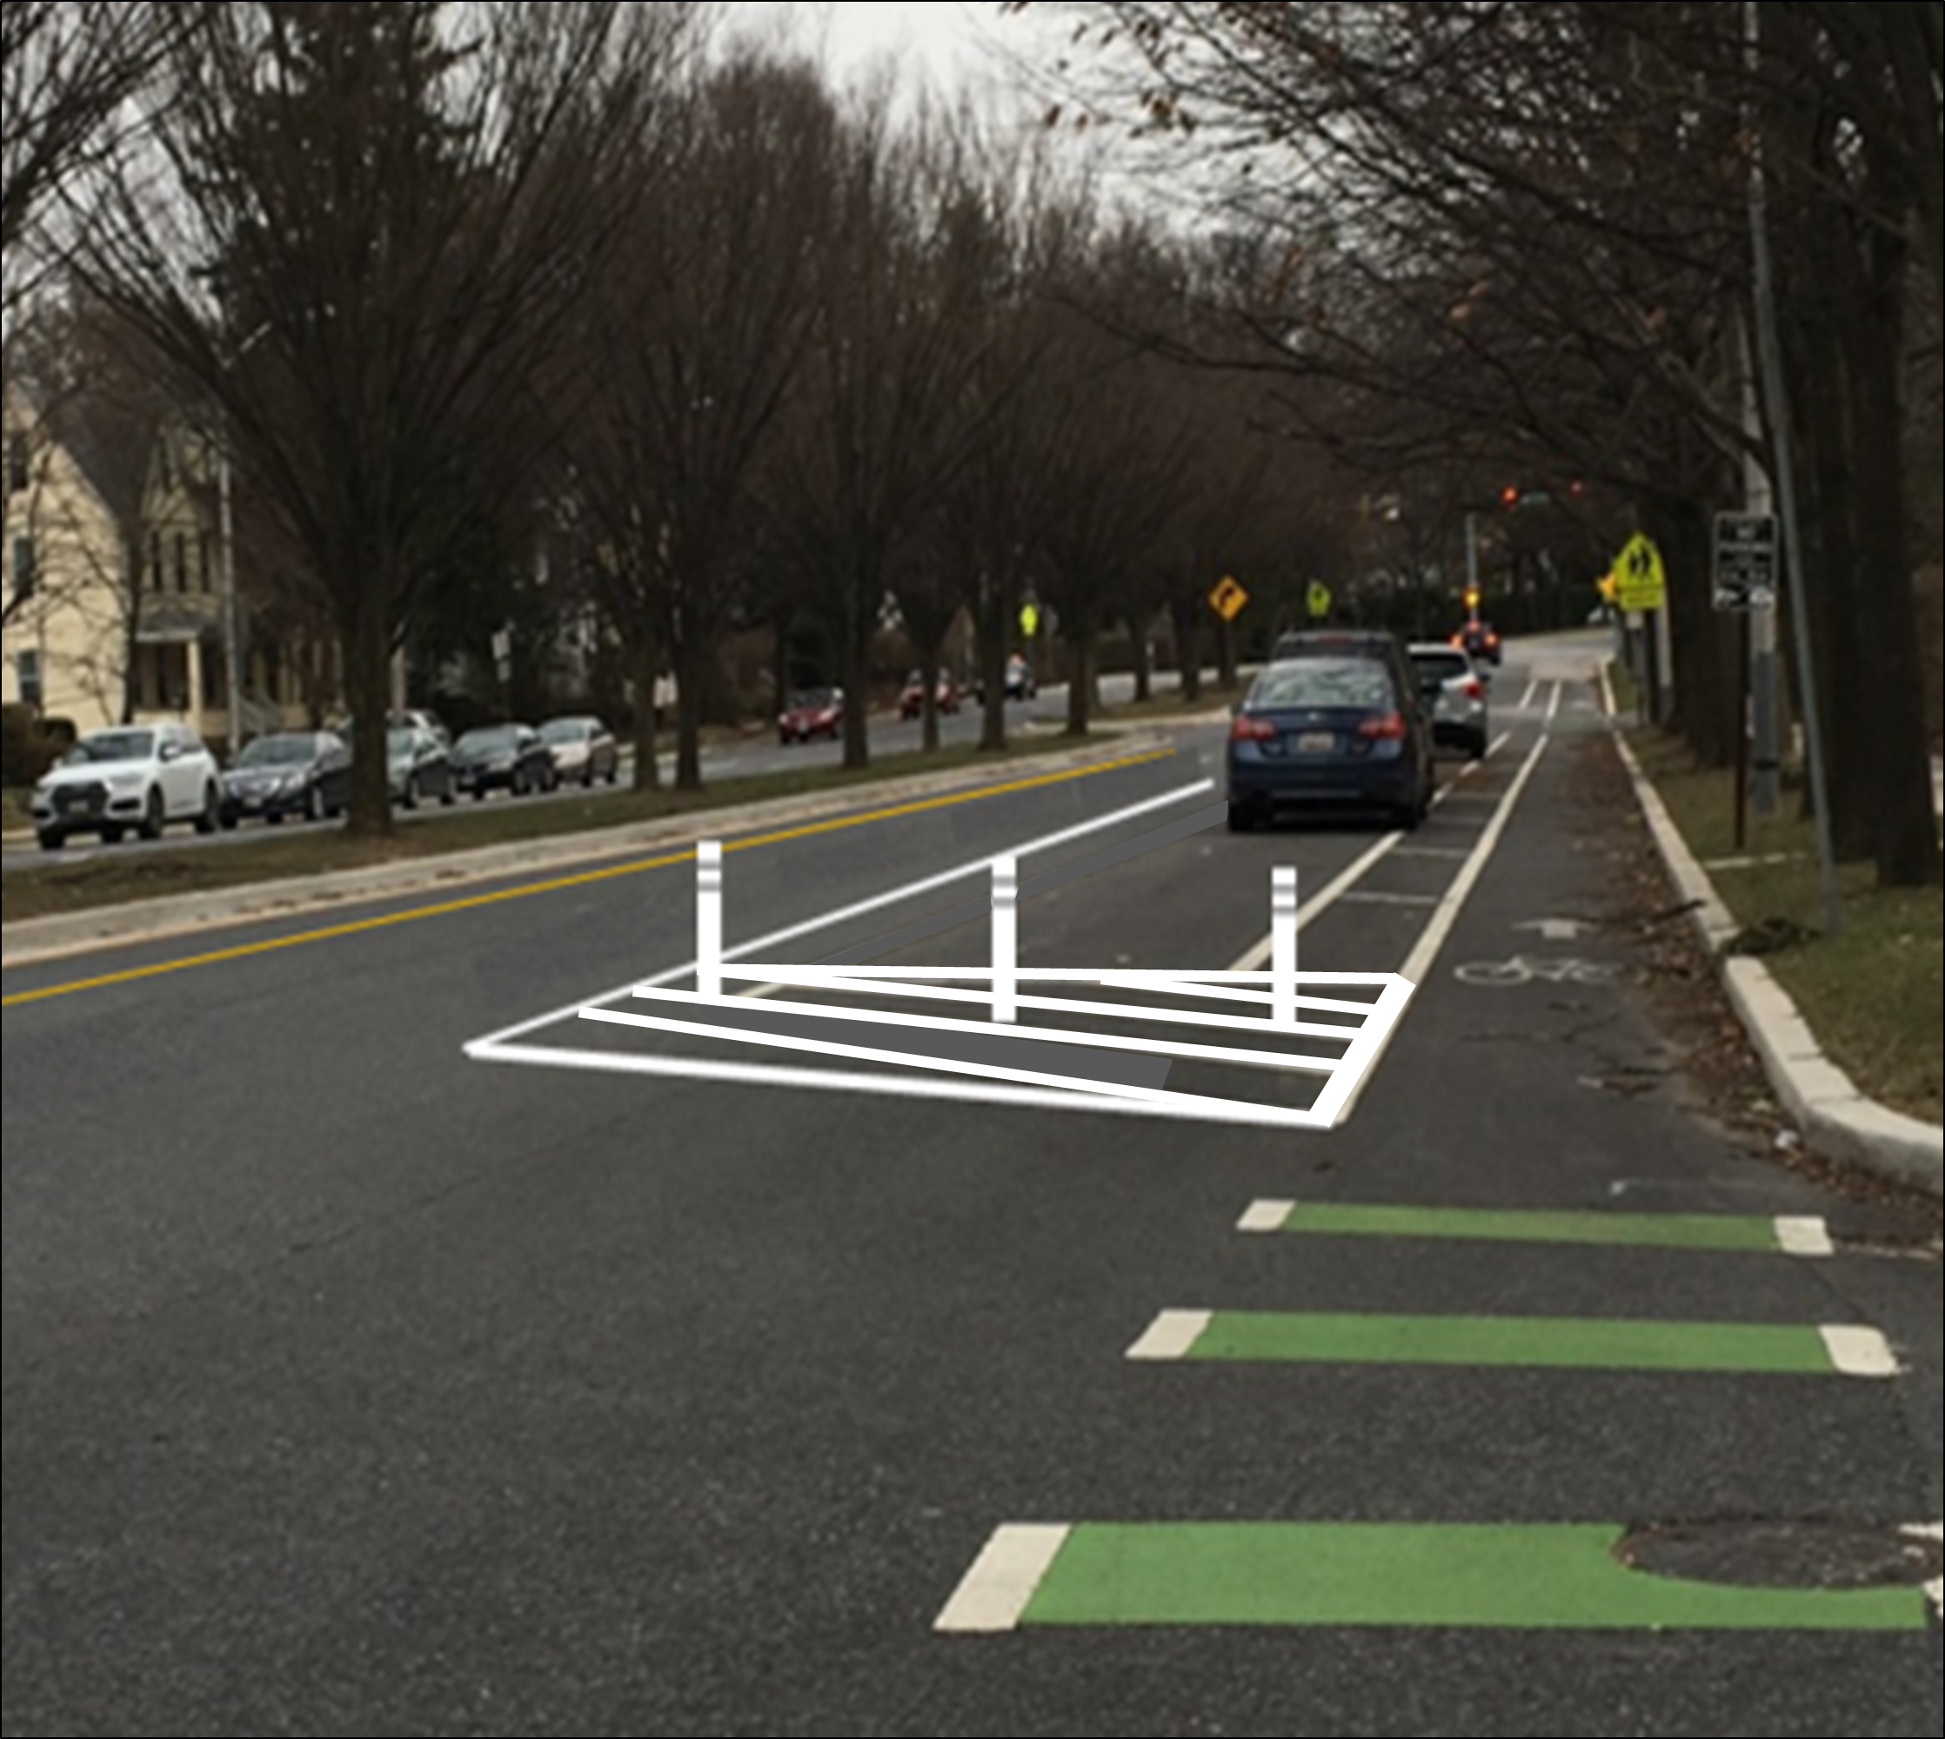
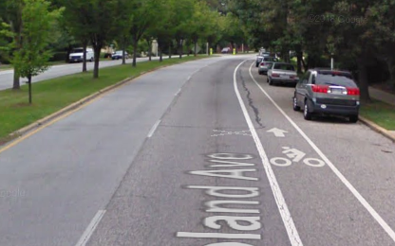
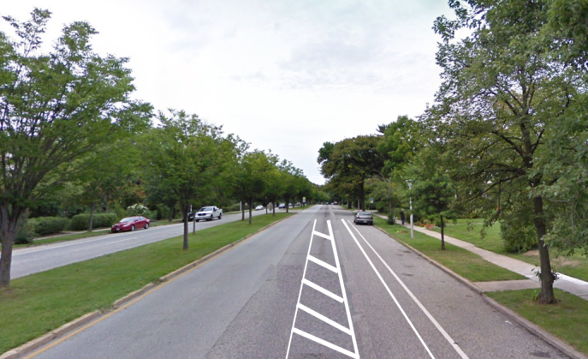
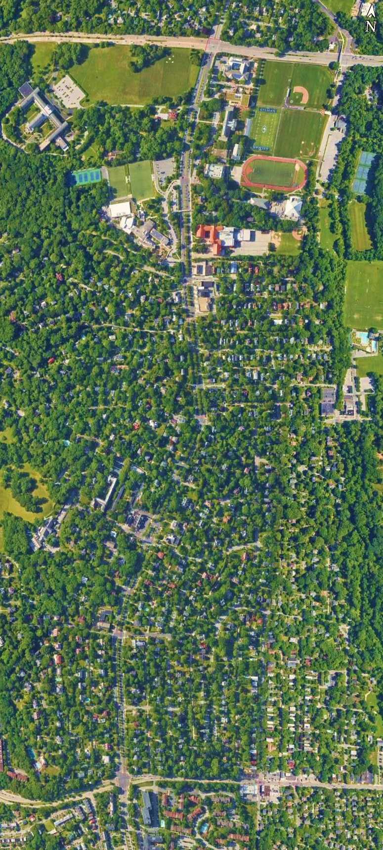
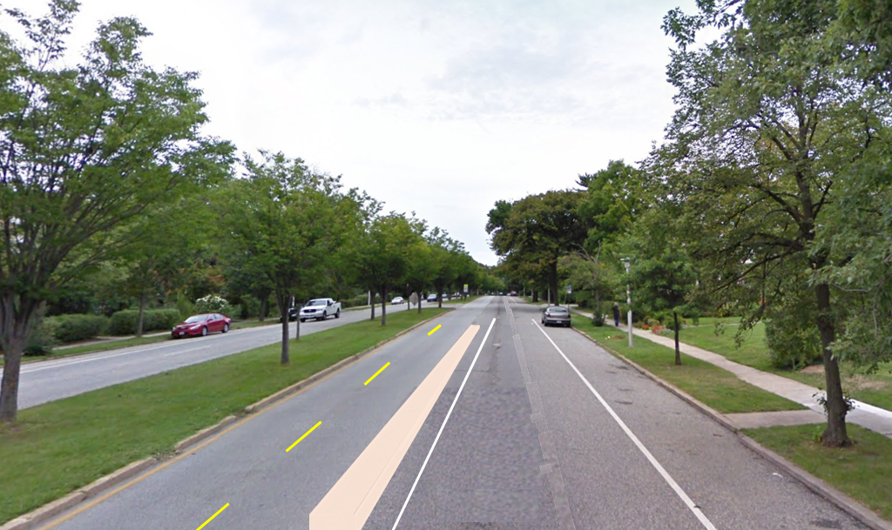
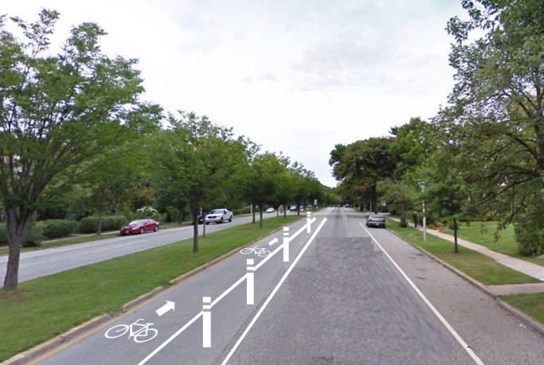
Roland Avenue Safety Enhancement Design Options
Project Area
Design Option Illustrations
1
2
3
Northern Parkway
Full extents of bike lane
Deepdene Road
4
 | Reduces Car-Door/Bicycle Conflicts | Provides Separated Bike Facility | Provides Curbside Parking | Reduces Vehicle Parking/ Travel Lane Conflicts | Encourages Reduction of Vehicle Speed | Reduction in Travel Lanes | 2018 Implementation | Less Than $250,000
Option 1 (preferred): Widen Parking lane, reduce travel lanes from two lanes to one in both directions |  |  | X |  |  |  |  | 
Option 2: Remove parking protected cycle track, curbside parking, bike lane alongside parked cars, maintain two travel lanes in both directions | X | X |  |  | X | X |  | X
Option 3: Remove parking protected cycle track, curbside parking, install buffered bike lane alongside parked cars, reduce travel lanes from two lanes to one in both directions |  | X |  |  |  |  |  | X
Option 4: Remove parking protected cycle track, curbside parking, northbound median running two-way flex post or curb delineated cycle track, southbound buffered bike lane alongside parked cars, reduce travel lanes from two lanes to one in both directions |  |  |  | X |  |  | X | X
Option 5: Remove parking protected cycle track, curbside parking, median running one-way flex post or curb delineated cycle track, reduce travel lanes from two lanes to one in both directions |  |  |  | X |  |  | X | X
Project area
5
Cold Spring Lane
Notes:
Remove all “pilot” language

Slide 3
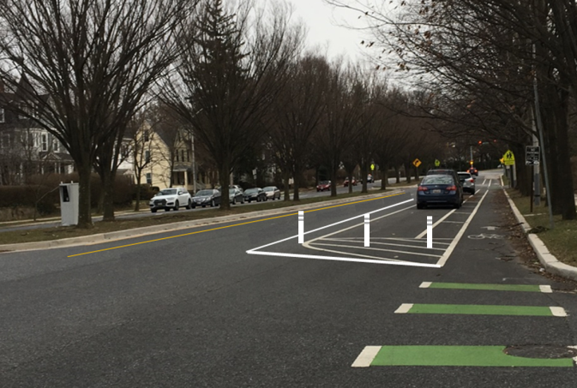
Design Option 1 (Preferred Option)
ProjectArea
Benefits and Trade-offs
 | Reduces Car-Door/Bicycle Conflicts | Provides Separated Bike Facility | Provides Curbside Parking | Reduces Vehicle Parking/ Travel Lane Conflicts | Encourages Reduction of Vehicle Speed | Reduction in Travel Lanes | 2018 Implementation | Less Than $250,000
Option 1: Widen Parking lane, reduce travel lanes from two lanes to one in both directions |  |  | X |  |  |  |  | 
Northern Parkway
Full extents of bike lane
Deepdene Road
Widen the Parking Lane
Reduce conflict between parked vehicles and travel lane
Reduce conflict between parked vehicles and bicycle lane
Create a safer more comfortable parking area
Create a safer more comfortable bicycle lane
Reduce the Travel Lanes from Two Lanes to One in Both Directions
Encourages reduction of vehicle speed
Create a safer more comfortable parking area
Create a safer more comfortable bicycle lane
Evaluate Impact on Traffic and Safety Concerns
Project area
Cold Spring Lane

Slide 4
Design Options 2 and 3
Project Area
Benefits and Trade-offs
Northern Parkway
 | Reduces Car-Door/Bicycle Conflicts | Provides Separated Bike Facility | Provides Curbside Parking | Reduces Vehicle Parking/ Travel Lane Conflicts | Encourages Reduction of Vehicle Speed | Reduction in Travel Lanes | 2018 Implementation | Less Than $250,000
Option 2: Remove parking protected cycle track, curbside parking, bike lane alongside parked cars, maintain two travel lanes in both directions | X | X |  |  | X | X |  | X
Option 3: Remove parking protected cycle track, curbside parking, install buffered bike lane alongside parked cars, reduce travel lanes from two lanes to one in both directions |  | X |  |  |  |  |  | X
Full extents of bike lane
Deepdene Road
Option 2
Option 3
Project area
Remove Parking Protected Cycle Track and Initiate Curbside Parking
Reduces conflict between parked vehicles and travel lane
Provides curbside parking
Install Bike Lane Alongside Parking Lane
Provides a bike facility
Maintain Two Travel Lanes in Both Directions
Remove Parking Protected Cycle Track and Initiate Curbside Parking
Reduces conflict between parked vehicles and travel lane
Provides curbside parking
Install Buffered Bike Lane Alongside Parking Lane
Reduce Travel Lanes from Two Lanes to One in Both Directions
Encourages reduction of vehicle speed
Create a safer more comfortable parking area
Cold Spring Lane

Slide 5
Design Options 4 and 5
Project Area
Benefits and Trade-offs
 | Reduces Car-Door/Bicycle Conflicts | Provides Separated Bike Facility | Provides Curbside Parking | Reduces Vehicle Parking/ Travel Lane Conflicts | Encourages Reduction of Vehicle Speed | Reduction in Travel Lanes | 2018 Implementation | Less Than $250,000
Option 4: Remove parking protected cycle track, curbside parking, northbound median running two-way flex post or curb delineated cycle track, southbound buffered bike lane alongside parked cars, reduce travel lanes from two lanes to one in both directions |  |  |  | X |  |  | X | X
Option 5: Remove parking protected cycle track, curbside parking, median running one-way flex post or curb delineated cycle track, reduce travel lanes from two lanes to one in both directions |  |  |  | X |  |  | X | X
Northern Parkway
Full extents of bike lane
Deepdene Road
Option 4
Option 5
Project area
Remove Parking Protected Cycle Track and Initiate Curbside Parking
Reduces conflict between parked vehicles and travel lane
Provides curbside parking
Install Median Running Two-Way Cycle Track on Northbound Lane
Provides separated bike facility
Reduces conflict between parked vehicles and bicycle lane
Install Buffered Bike Lane on Southbound Lane
Reduces conflict between parked vehicles and bicycle lane
Reduce Travel Lanes from Two Lanes to One in Both Directions
Encourages reduction of vehicle speed
Create a safer more comfortable parking area
Remove Parking Protected Cycle Track and Initiate Curbside Parking
Reduces conflict between parked vehicles and travel lane
Provides curbside parking
Install Median Running One-Way Cycle Track in Both Directions
Provides separated bike facility
Reduces conflict between parked vehicles and bicycle lane
Reduce Travel Lanes from Two Lanes to One in Both Directions
Encourages reduction of vehicle speed
Create a safer more comfortable parking area
Create a safer more comfortable bicycle lane
Cold Spring Lane

Slide 6
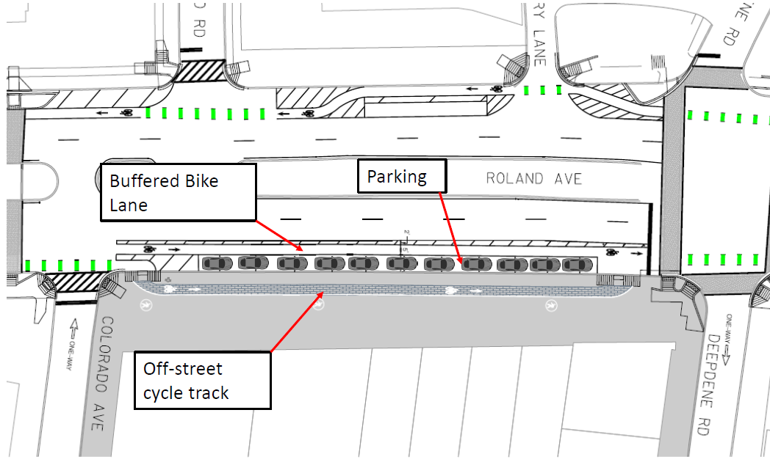
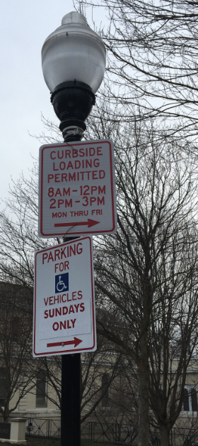
Evaluation Results, Recent Progress, and Imminent Changes
Evaluation Findings
Imminent Changes
Evaluation assessed vehicle speeds, cyclist behavior, and user/community perceptions of roadway conditions. Notable findings include:
Excessive speeds documented by Speed Sentry devices on Roland Avenue
People feel parking lanes and cycle track are too narrow
The majority of cyclists do use the cycle track
A higher percentage use the cycle track in the northbound (uphill) direction
A lower percentage use the cycle track in the southbound (downhill) direction – this is likely due to higher bicyclist speeds while traveling downhill
Traffic volumes are low, outside of peak hours
The following changes are scheduled for construction in 2018:
Curbside parking will be restored on the east side of Roland Avenue between Colorado Avenue and Deepdene Road
An off-street bike path and a door-side buffered bike lane will both be installed in this segment
Benefits and Trade-offs
Option 5
Recent Progress
The following changes to address community member concerns have been implemented in recent months:
Addressed Sight-Line Issues at Key Intersections
Restored Curbside Loading at Day School
Increased Traffic Enforcement Officer Presence
Implemented Speed Cameras and Speed Sentry Devices
Installed Stronger Flex Posts
Curbside Loading Sign
Speed Sentry

Slide 7
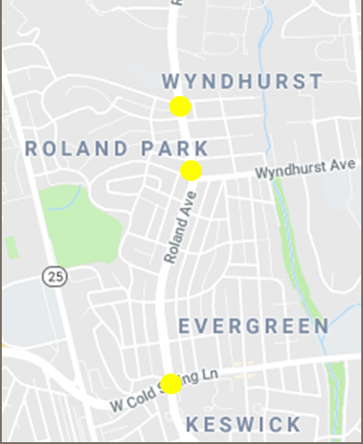
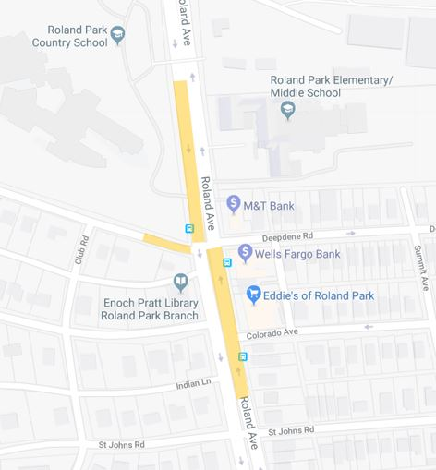
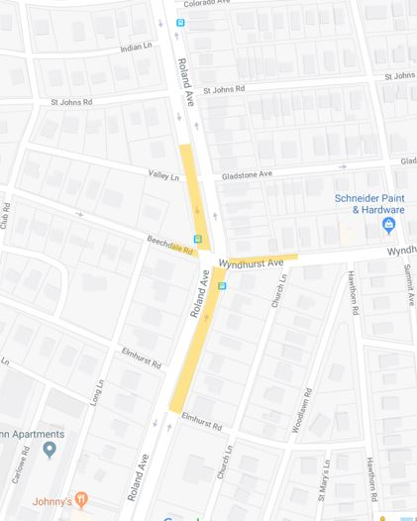
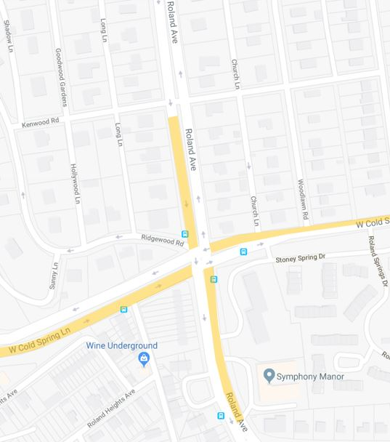
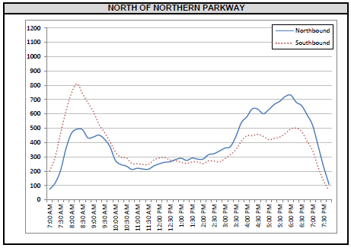
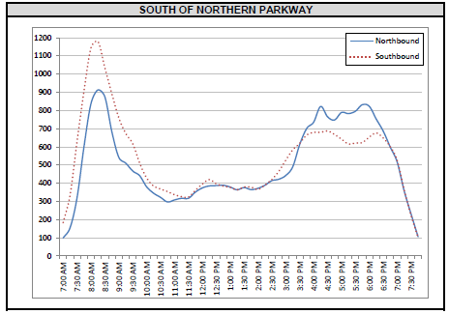
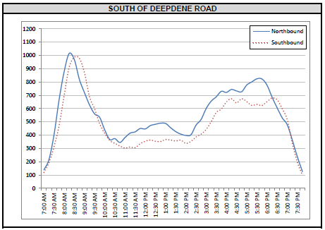
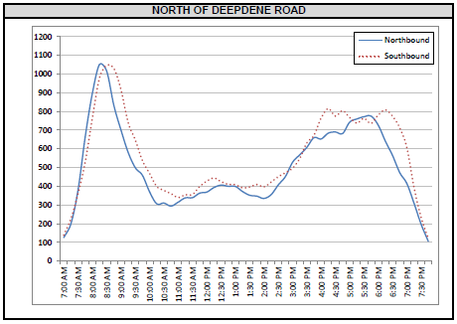
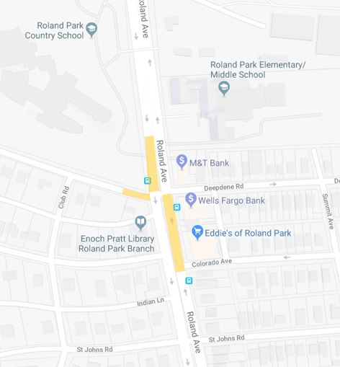
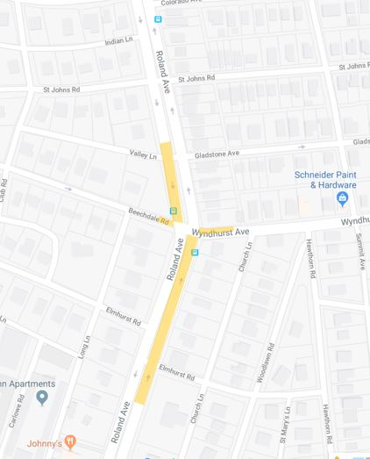
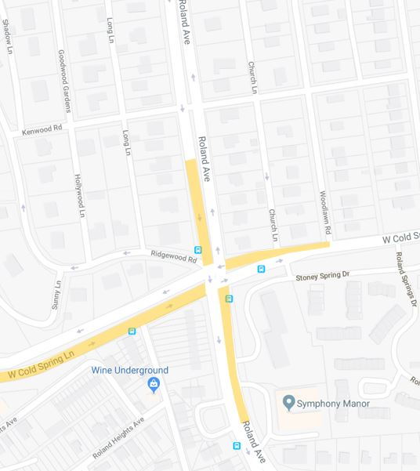
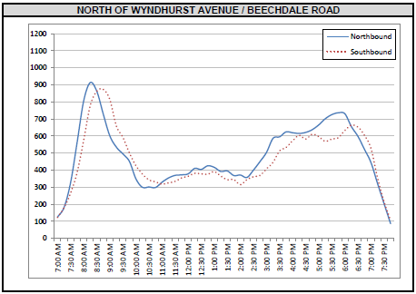
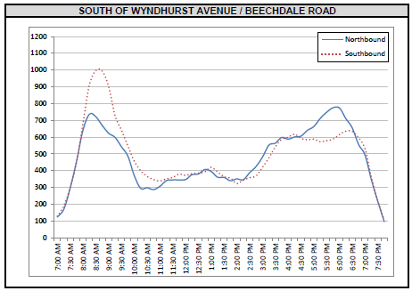
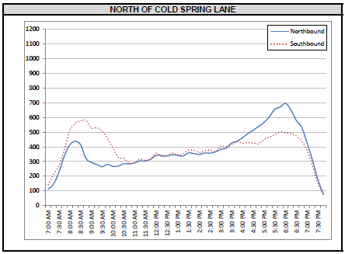
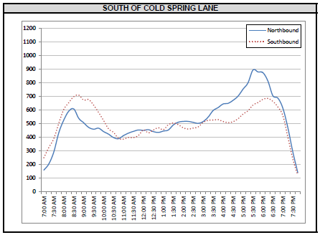
Remove Parking Protected Cycle Track and Initiate Curbside Parking
Reduces conflict between parked vehicles and travel lane
Provides curbside parking
Install Median Running One-Way Cycle Track in Both Directions
Provides separated bike facility
Reduces conflict between parked vehicles and bicycle lane
Reduce Travel Lanes from Two Lanes to One in Both Directions
Encourages reduction of vehicle speed
Create a safer more comfortable parking area
Create a safer more comfortable bicycle lane
Traffic Effects of Travel Lane Reduction
Intersection Data Collection
Predicted AM Peak Hour Queue Lengths After Lane Reduction
A study was conducted to determine the traffic operations effects of a road diet on Roland Avenue. Traffic volumes were collected at the following intersections:
Roland Avenue at Cold Spring Lane
Roland Avenue at Wyndhurst Avenue
Roland Avenue at Deepdene Road
High Peak Hour Traffic Volumes
Option 5
ROLAND AVENUE DEEPDENE ROAD
ROLAND AVENUE AT WYNDHURST AVENE
ROLAND AVENUE AT COLD SPRING LANE
Predicted PM Peak Hour Queue Lengths After Lane Reduction
ROLAND AVENUE DEEPDENE ROAD
ROLAND AVENUE AT WYNDHURST AVENE
ROLAND AVENUE AT COLD SPRING LANE
Traffic Analysis Results: Level of Service
Predicted Travel Time Changes After Lane Reduction
Minor additional delays can be expected during the peak hours if a road diet is implemented.
Minor increases in travel time can be expected during the peak hours if a road diet is implemented.
 | AM Peak |  |  |  | PM Peak
 | Two Lane |  | One Lane |  | Two Lane |  | One Lane
Intersection | Average Delay(s) | Intersection LOS | Average Delay(s) | Intersection LOS | Average Delay(s) | Intersection LOS | Average Delay(s) | Intersection LOS
Deepdene Rd | 19.8 | B | 11.6 | B | 2.4 | A | 3 | A
Wyndhurst Ave | 24.9 | C | 44.8 | D | 15.2 | B | 23.3 | C
Cold Spring Ln | 77.8 | E | 80.8 | E | 113.7 | F | 113.7 | F
 | AM Peak |  | PM Peak
 | Two Lane | One Lane | Two Lane | One Lane
Northbound (Cold Spring Lane to Northern Parkway) | 5 minutes | 6-7 minutes | 5 minutes | 6 minutes
Southbound (Northern Parkway to Cold Spring Lane) | 4 minutes | 5 minutes | 4 min | 4-5 minutes

